Slide 1
Building Android apps – Week 4a
2843-201710_MCS4993_M:Topics in MA/CS
2843-201710_MCS5993_M:Topics in Computer Science

Slide 2
Agenda
Chapter 6 HFAD – List Views and Adapters
Notes:
Going to look at creating an app from scratch, it’s called Stabuzz, so obviously a Starbucks knockoff.
Useful as it can show how to go around figuring out what they

Slide 3
Bullet Points
Sort your ideas for activities into top-level activities, category activities, and detail/edit activities. Use the category activities to navigate from the top-level activities to the detail/edit activities.
Image resources go in one or more of the drawable* folders. You reference them in your layout using @drawable/image_name. You access them in your activity code using R.drawable. image_name.
An ImageView holds an image. Add it to your layout using <ImageView>. Use android:src to set its source, and android:contentDescription to give it an accessible label. The equivalent methods in Java are setImageResource() and setContentDescription().
A ListView displays items in a list. Add it to your layout using <ListView>.
Use android:entries in your layout to populate the items in your list views from an array defined in strings.xml.

Slide 4
Bullet Points
A ListActivity is an Activity that comes with a ListView. You get a reference to the ListView using getListView().
A ListActivity has its own default layout, but you can replace it with your own.
An adapter acts as a bridge between an AdapterView and a data source. ListViews and Spinners are both types of AdapterView.
An ArrayAdapter is an adapter that works with arrays.
Handle click events on Buttons using android:onClick in the layout code.
Handle click events on a ListView in a ListActivity by implementing the onListItemClick() method.
Handle click events elsewhere by creating a listener and implementing its click event.

Slide 5
Notes:
Usually start by listing requirements – there’s a format for this, titles are always listed as goals
Reflect User Goals, Short, Use Meaningful verbs, active voice (display, show), don’t identify actors

Slide 6
Top Level Activity
Notes:
A top-level activity contains the things that are most important to the user, and gives them an easy way of navigating to them. In most apps, the first activity the user sees will be a top-level activity.

Slide 7
Category Activities
Notes:
Category activities show the data that belongs to a particular category, often in a list. These type of activities are often used to help the user navigate to detail/edit activities. An example of a category activity is a list of all the drinks available at Starbuzz.

Slide 8
Detail/Edit Activities
Notes:
Detail/edit activities display details for a particular record, let the user edit the record, or allow the user to enter new records. An example of a detail/edit activity would be an activity that shows the user the details of a .
Once you’ve categorized your activities, you can use them to construct a hierarchy showing how the user will navigate between activities.particular drink

Slide 9
Navigating through the Activities
Notes:
Top-level activities go at the top These are the activities your user will encounter first, so they go at the top.
Category activities go between top-level and detail/edit activities Your users will navigate from the top-level activity to the category activities. In complex apps, you might have several layers of categories and subcategories.
Detail/edit activitiesThese form the bottom layer of the activity hierarchy. Users will navigate to these from the category activities

Slide 10
List Views for Categories
Notes:
When you structure your app in this way, you need a way of navigating between your activities. A common approach used in this situation is to use list views. A list view allows you to display a list of data that you can then use to navigate through the app.
The activity uses a list view to display all the drinks that are sold by Starbuzz. To navigate to a particular drink, the user clicks on one of the drinks, and the details of that drink are displayed.

Slide 11
Drink Activity
Notes:
The drink activity is launched when the user clicks on one of the drinks listed by the drink category activity.This activity displays details of the drink the user has selected, such as its name, an image of what it looks like, and a desciption.

Slide 12
Top and Category
Notes:
Rather than build all the category and detail/edit activities required for the entire Starbuzz app, we’re going to focus on just the drinks. We’re going to build a top-level activity that the user will see when they launch the app, a category activity that will display a list of drinks, and a detail/edit activity that will display details of a single drink. When the user launches the app, they will be presented with the top-level activity, the main entry point of the app. This activity includes an image of the Starbuzz logo, and a navigational list containing entries for Drinks, Food, and Stores. When the user clicks on an item in the list, the app uses the selection to navigate to a separate activity. As an example, if the user clicks on Drinks, the app starts a category activity relating to drinks. They then navigate to the drink activity by clicking on a drink.

Slide 13
Starbuzz App Structure
Notes:
The app contains three activities. TopLevelActivity is the app’s top-level activity and allows the user to navigate through the app. DrinkCategoryActivity is a category activity; it contains a list of all the drinks. The third activity, DrinkActivity, displays details of a given drink.
When the app gets launched, it starts activity TopLevelActivity.The activity uses layout activity_top_level.xml. The activity displays a list of options for Drinks, Food, and Stores.
The user clicks on Drinks in TopLevelActivity.This launches activity DrinkCategoryActivity. This activity displays a list of drinks.
Details of the drinks are held in the Drink.java class file.DrinkCategoryActivity gets the values for its list of drinks from this class.
The user clicks on a drink in DrinkCategoryActivity.This launches activity DrinkActivity. The activity uses layout activity_drink. xml.
DrinkActivity gets details of the drink from the Drink.java class file.

Slide 14
Steps
Create Project
Add the Drink class and image resources
Create TopLevelActivity and its layout
Create DrinkCategoryActivity (no layout needed)
Create DrinkActivity and it’s layout
Notes:
DrinkCategoryActivity doesn’t need a layout as it’s a ListActivity

Slide 15
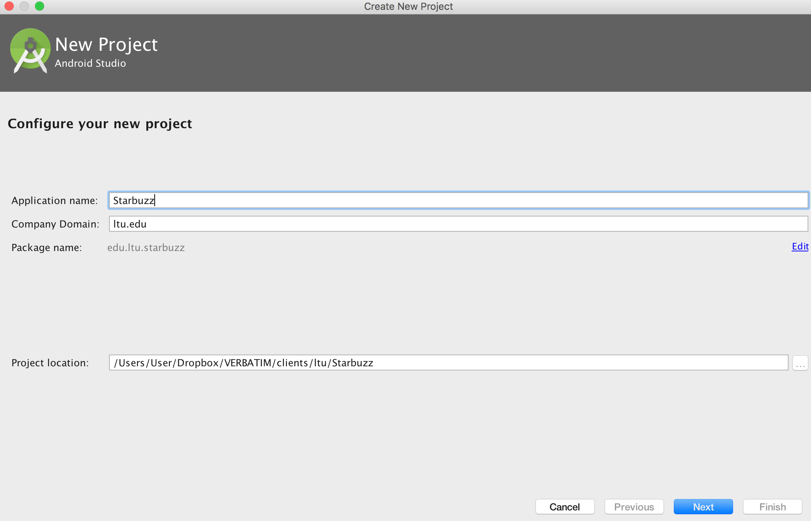
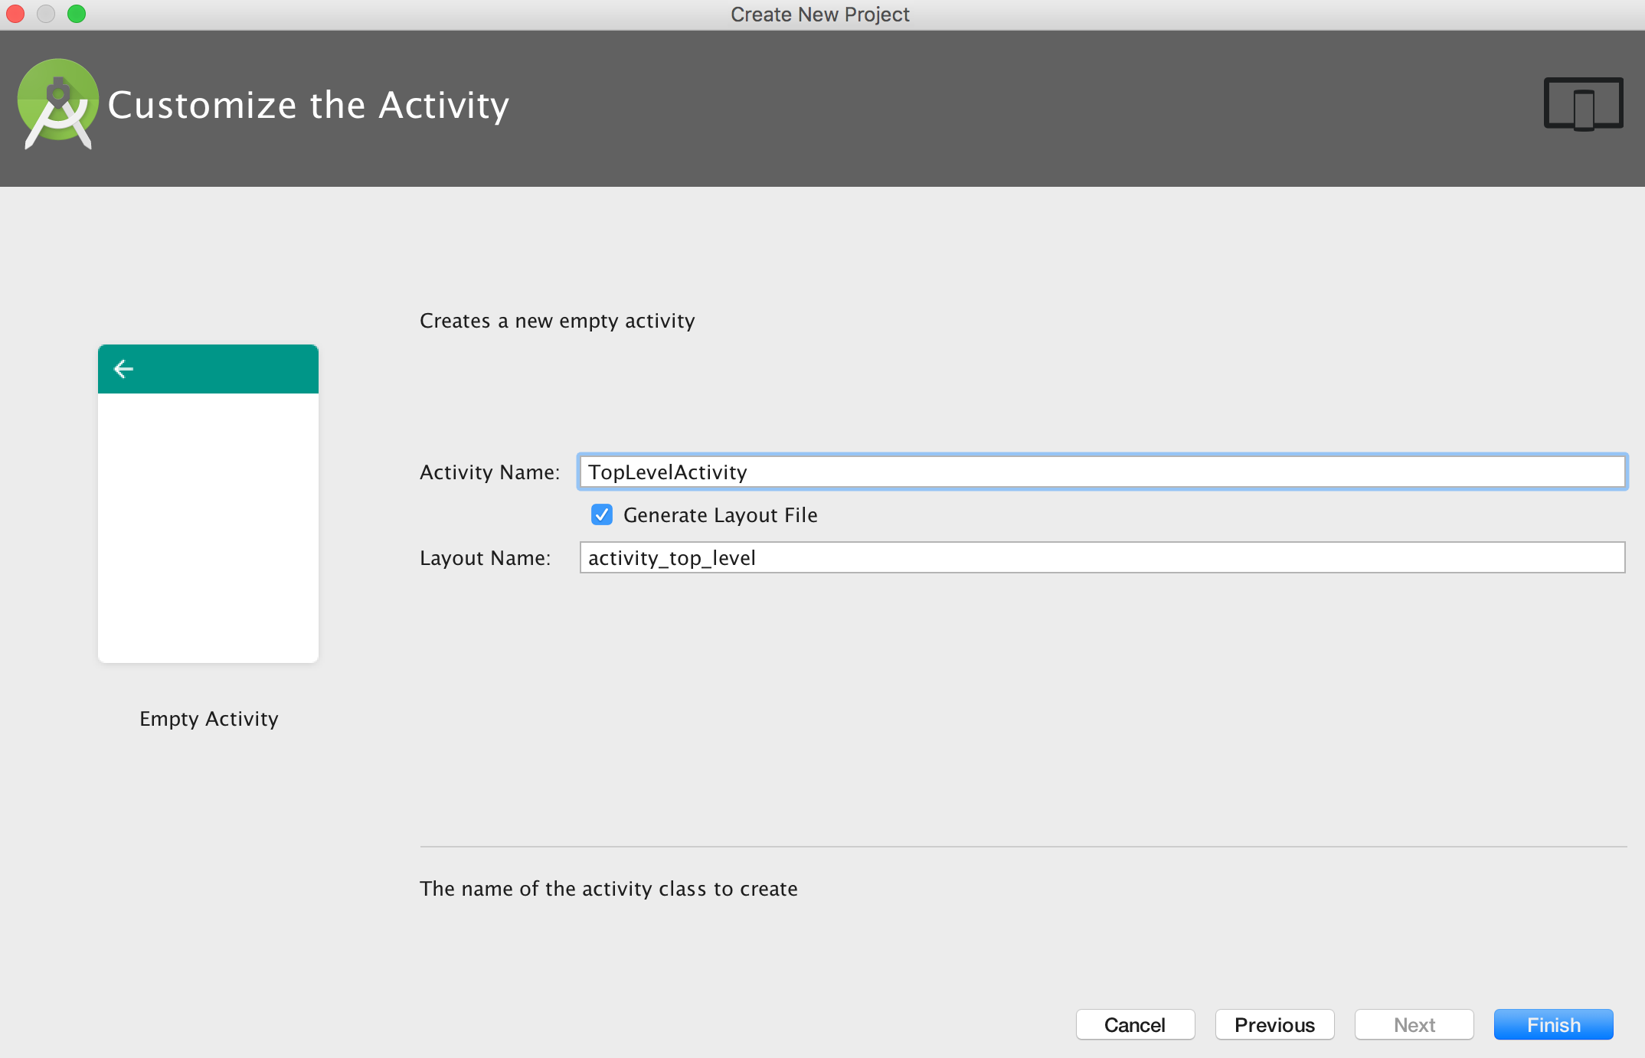
Notes:
Create the Starbuzz project, call the main activity – TopLevelActivity

Slide 16
Notes:
We’ll start by adding the Drink class to the app. Drink.java is a pure Java class file that activities will get their drink data from. The class defines an array of three drinks, where each drink is composed of a name, description, and image resource ID. Add the class to the com.hfad.starbuzz package in the app/src/main/java folder in your project, giving it a class name of Drink. Then save your changes.
The Drink code includes three image resources for its drinks with ids of R.drawable.latte, R.drawable.cappuccino and R.drawable.filter. These are so we can show the user images of the drinks. R.drawable.latte refers to an image file called latte, R.drawable.cappuccino refers to an image file called cappuccino, and R.drawable.filter refers to a file called filter.

Slide 17
Notes:
We need to add these image files to the project, along with an image of the Starbuzz logo so that we can use it in our top-level activity. To do this, download the files starbuzz-logo.png, cappuccino. png, filter.png, and latte.png from https://tinyurl.com/HeadFirstAndroid. Then drag the file to the app/src/main/res/drawable folder in your Starbuzz project. When you add images to your apps, you need to decide whether to display different images for different density screens. In our case, we’re going to use the same resolution image irrespective of screen density, so we’ve put a single copy of the images in one folder. If you decide to cater for different screen densities in your own apps, put images for the different screen densities in the appropriate drawable* folders as described in Chapter 5.

Slide 18
Images
Notes:
When you save images to your project, Android assigns each of them an ID in the form R.drawable.image_name. As an example, the file latte.png is given an ID of R.drawable. latte, which matches the value of the latte’s image resource ID in the Drink class.

Slide 19
TopLevelActivity
Notes:
When we created our project, we called our default activity TopLevelActivity.java, and its layout activity_top_level.xml. We need to change the layout so it displays an image and a list.

Slide 20
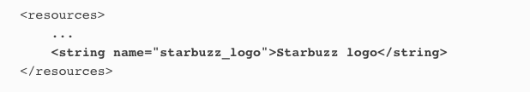
TopLevelActivity
Notes:
Here’s the code to define the image view in the layout:
When you use an image view in your app, you can use the android:contentDescription attribute to add a description of the image; this makes your app more accessible. In our case, we’re using a string value of "@string/starbuzz_logo". We then add this to strings.xml:

Slide 21
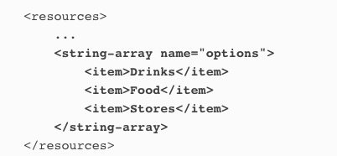
TopLevelActivity
Notes:
You add a list view to your layout using the <ListView> element. You then add an array of entries to the list view by using the android:entries attribute and setting it to an array of strings. The array of strings then gets displayed in the list view as a list of text views.
You define the array in strings.xml

Slide 22
TopLevelActivity
Notes:
The listview is now populated with three values: Drinks, Food, and Stores.

Slide 23
Notes:
Here’s the layout code in full

Slide 24
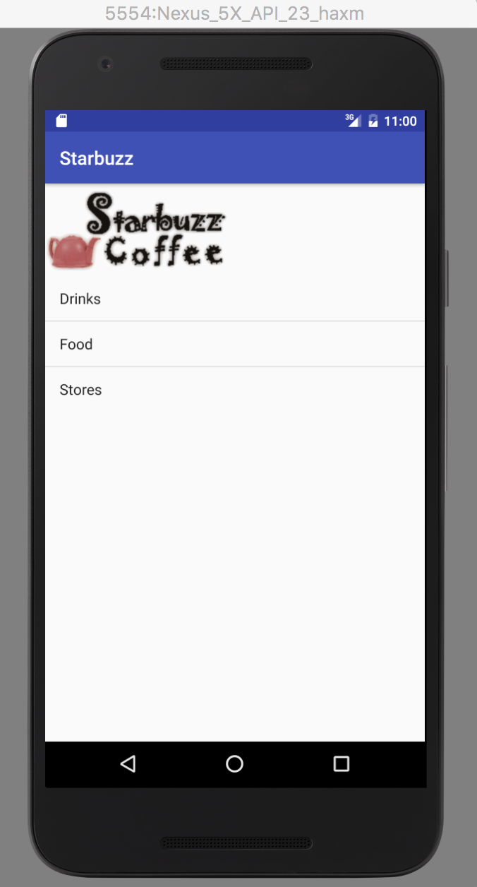
Test Drive
Notes:
Make sure you’ve applied all the changes to activity_top_level.xml, and also updated strings.xml. When you run the app, you should see the Starbuzz logo displayed on the device screen with the list view underneath it. The list view displays the three values from the options array. If you click on any of the options in the list, nothing happens, as we haven’t told the list view to respond to clicks yet.
The next thing we’ll do is see how you get list views to respond to clicks and launch a second activity.

Slide 25
TopLevelActivity
Notes:
An event listener allows you to listen for events that take place in your app, such as when views get clicked, when they receive or lose the focus, or when the user presses a hardware key on their device. By implementing an event listener, you can tell when your user performs a particular action—such as clicking on an item in a list view—and respond to it.

Slide 26
TopLevelActivity
Notes:
When you want to get items in a list view to respond to clicks, you need to create an OnItemClickListener and implement its onItemClick() method. The OnItemClickListener listens for when items are clicked, and the onItemClick() method lets you say how your activity should respond to the click. The onItemClick() method includes several parameters that you can use to find out which item was clicked, such as a reference to the view item that was clicked, its position in the list view (starting at 0), and the row ID of the underlying data.
We want to start DrinkCategoryActivity when the first item in the list view is clicked—the item at position 0. If the item at position 0 is clicked, we need to create an intent to start DrinkCategoryActivity. Here’s the code to create the listener:

Slide 27
TopLevelActivity
Notes:
Once you’ve created the OnClickItemListener, you need to attach it to the list view. You do this using the ListView setOnItemClickListener() method. The method takes one argument, the list
Adding the listener to the list view is crucial, as it’s this step that makes the listener get notified when the user clicks on items in the list view. If you don’t do this, the items in your list view won’t be able to respond to clicks.ener itself:

Slide 28
TopLevelActivity
Notes:
What happens when you run the code
The onCreate() method in TopLevelActivity creates an onItemClickListener and links it to the activity’s ListView.
When the user clicks on an item in the list view, the onItemClickListener’s onItemClick() method gets called.
If the Drinks item is clicked, the onItemClickListener creates an intent to startDrinkCategoryActivity.

Slide 30
DrinkCategoryActivity
Notes:
So far we’ve added Drink.java to our app and created TopLevelActivity and its layout.
The next thing we need to do is create DrinkCategoryActivity so that it gets launched when the user clicks on the Drinks option in TopLevelActivity.

Slide 31
Notes:
DrinkCategoryActivity is an example of a category activity. A category activity is one that shows the data that belongs to a particular category, often in a list. You then use the category activity to navigate to details of the data. We’re going to use DrinkCategoryActivity to display a list of drinks. When the user clicks on one of the drinks, we’ll show them the details of that drink.
To do this, we’ll create an activity containing a single list view that displays a list of all the drinks. As our activity only needs to contain a single list view with no other GUI components, we can use a special kind of activity called a list activity. So what’s a list activity? A list activity is type of activity that specializes in working with a list. It’s automatically bound to a list view, so you don’t need to create one yourself.

Slide 32
Notes:
There are a couple of major advantages in using a list activity to display categories of data:
You don’t need to create your own layout.
List activities define their own layout programmatically, so there’s no XML layout for you to create or maintain. The layout the list activity generates includes a single list view. You access this list view in your activity code using the list activity’s getListView() method. You need this to specify what data should be displayed in the list view.
You don’t have to implement your own event listener.
The ListActivity class already implements an event listener that listens for when items in the list view are clicked. Instead of creating your own event listener and binding it to the list view, you just need to implement the list activity’s onListItemClick() method. This makes it easier to get your activity to respond when the user clicks on items in the list view. You’ll see this in action later on when we use theonListItemClick() method to start another activity.
A ListActivity is a type of Activity that specializes in working with a ListView. It has a default layout that contains the ListView.
Category activities generally need to display a single list view you can use to navigate to detail records, so list activities are good for this situation.

Slide 33
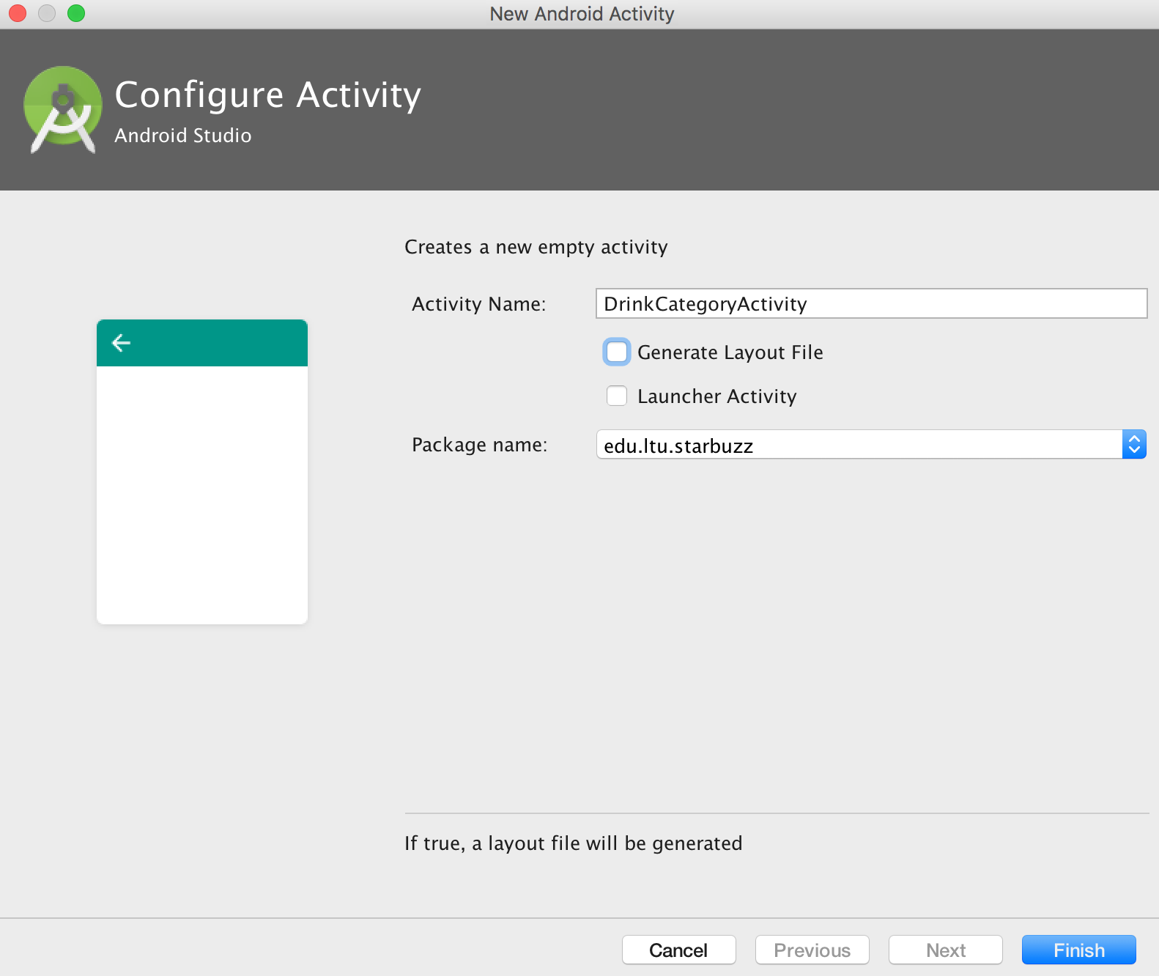
Notes:
Create the new activity and uncheck the Generate Layout File

Slide 34
DrinkCategoryActivity
Notes:
Here’s what the basic code looks like to create a list activity. As you can see, it’s very similar to creating an activity. Use the New Activity wizard to create a new activity in your project calledDrinkCategoryActivity, then replace the contents of DrinkCategoryActivity.java with the code below:
The above code creates a basic list activity called DrinkCategoryActivity. Because it’s a list activity, it needs to extend the ListActivity class rather than Activity. The other difference is that you don’t need to use the setContentView() method to say what layout the list activity should use. This is because list activities define their own layouts so you don’t need to create one yourself. The list activity handles this for you.

Slide 35
DrinkCategoryActivity
Notes:
Just as with normal activities, list activities need to be registered in the AndroidManifest.xml file. This is so they can be used within your app. When you create your activity, Android Studio does this for you.

Slide 36
DrinkCategoryActivity
Notes:
If there’s no layout how are we going to get the data in ListView, we can’t reference the strings.xml like we normally do

Slide 37
DrinkCategoryActivity
Notes:
If you need to display data in a list view that comes from a nonstatic source such as a Java array or database, you need to use an adapter. An adapter acts as a bridge between the data source and the list view. An adapter acts as a bridge between a View and a data source. An ArrayAdapter is a type of adapter that specializes in working with arrays.

Slide 38
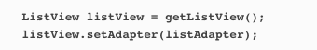
DrinkCategoryActivity
Notes:
To initialize the array adapter, you first specify what type of data is contained in the array you want to bind to the list view. You then pass it three parameters: a Context (usually the current activity), a layout resource that specifies how to display each item in the array, and the array itself. Here’s the code to create an array adapter that displays Drink data from the Drink.drinks array.
You then attach the array adapter to the list view using the ListView setAdapter() method
Behind the scenes, the array adapter takes each item in the array, converts it to a String using its toString() method and puts each result into a text view. It then displays each text view as a single row in the list view.

Slide 39
Notes:
Show code in Android Studio

Slide 40
Notes:
Run the app in Emulator and show it working. Set some breakpoints.

Slide 41
Notes:
1. When the user clicks on the Drinks option, DrinkCategoryActivity is launched.As DrinkCategoryActivity is a list activity, it has a default layout containing a single ListView object. This layout is created behind the scenes in Java code, so it’s not defined by XML.
2. DrinkCategoryActivity creates an ArrayAdapter<Drink>, an array adapter that deals with arrays of Drink objects.
3. The array adapter’s source is the drinks array in the Drink class.
It uses the Drink.toString() method to return the name of each drink.
4. DrinkCategoryActivity makes the ListView use the array adapter using the setAdapter() method.
The list view uses it to display a list of the drink names.

Slide 42
DrinkCategoryActivity
Notes:
The next thing we’ll do is get DrinkCategoryActivity to launch DrinkActivity, passing it details of which drink was clicked.

Slide 43
DrinkCategoryActivity
Notes:
Earlier on in the chapter, we needed to get TopLevelActivity to react to the user clicking items in the list view. To do that, we had to create an OnItemClickListener, implement its onItemClick() method, and assign it to the list view (show it!!)
We had to set up an event listener in this way because list views aren’t hardwired to respond to clicks in the way that buttons are.
So how should we get DrinkCategoryActivity to handle user clicks?
ListActivity implements an item click listener by default
There’s a significant difference between TopLevelActivity and DrinkCategoryActivity. Whereas TopLevelActivity is a normal Activity object, DrinkCategoryActivity is a ListActivity, a special type of activity that’s designed to work with list views.
This is significant when it comes to handling user clicks. A key difference between Activity and ListActivity is that the ListActivity class already implements an on item click event listener. Instead of creating your own event listener, when you use a list activity you just need to implement the onListItemClick() method.

Slide 44
DrinkActivity
Notes:
Pass data to an activity using the ListActivity onListItemClick() method
When you use a list activity to display categories, you’ll usually use the onListItemClick() method to start another activity that displays details of the item the user clicked. To do this, you create an intent that starts the second activity. You then add the ID of the item that was clicked as extra information so that the second activity can use it when the activity starts.
In our case, we want to start DrinkActivity and pass it the ID of the drink that was selected. DrinkActivity will then be able to use this information to display details of the right drink.

Slide 45
DrinkCategoryActivity
Notes:
It’s common practice to pass the ID of the item that was clicked as it’s the ID of the underlying data. If the underlying data is an array, the ID is the index of the item in the array. If the underlying data comes from a database, the ID is the ID of the record in the table. Passing the ID of the item in this way means that it’s easier for the second activity to get details of the data, and then display it.That’s everything we need to make DrinkCategoryActivity start DrinkActivity and tell it which drink was selected.

Slide 47
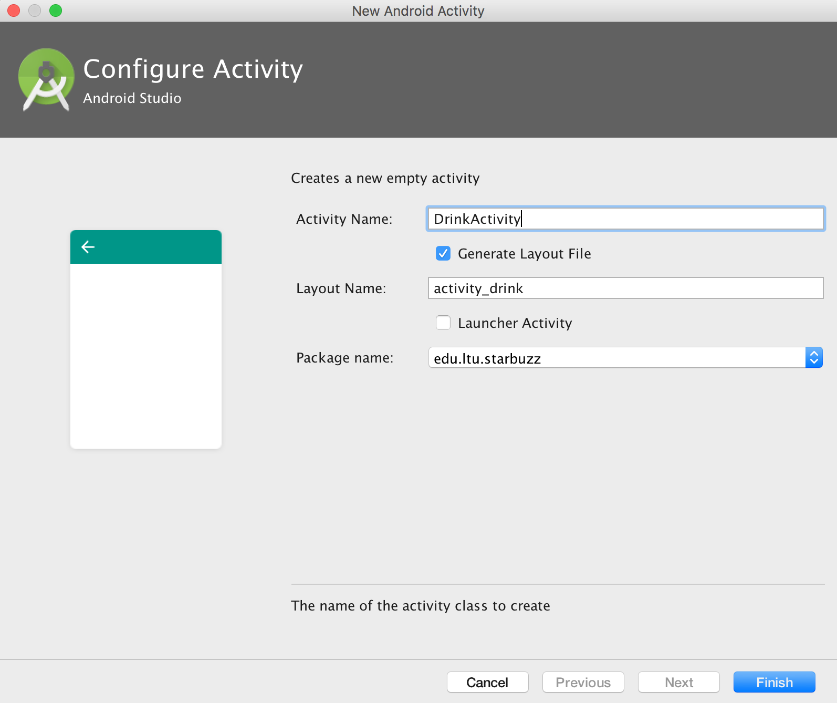
Notes:
Create the DrinkActivity with the activity_drink layout

Slide 48
Notes:
Once you’ve created the layout of your detail activity, we can populate its views.

Slide 49
DrinkActivity
//Get the drink from the intent int drinkNo = (Integer)getIntent().getExtras().get(EXTRA_DRINKNO); Drink drink = Drink.drinks[drinkNo];
Notes:
As you’ve seen, when you get a category activity to start a detail activity, you get items in the category activity list view to respond to clicks. When an item is clicked, you create an intent to start the detail activity. You pass the ID of the item the user clicked as extra information in the intent.When the detail activity is started, the detail activity can retrieve the extra information from the intent and use it to populate its views. In our case, we can use the information in the intent that started DrinkActivity to retrieve details of the drink the user clicked.
When we created DrinkCategoryActivity, we added the ID of the drink the user clicked as extra information in the intent. We gave it a label of DrinkActivity.EXTRA_DRINKNO, which we need to define as a constant in DrinkActivity:
public static final String EXTRA_DRINKNO = "drinkNo";
As you saw in Chapter 3, you can retrieve the intent that started an activity using the getIntent() method. If this intent has extra information, you can use the intent’s get*() methods to retrieve it. Here’s the code to retrieve the value of EXTRA_DRINKNO from the intent that started DrinkActivity:int drinkNo = (Integer)getIntent().getExtras().get(EXTRA_DRINKNO);
Once you’ve retrieved the information from the intent, you can use it to get the data you need to display in your detail record.
In our case, we can use drinkNo to get details of the drink the user selected. drinkNo is the ID of the drink, the index of the drink in the drinks array. This means that you can get the drink the user clicked on using:Drink drink = Drink.drinks[drinkNo];

Slide 50
Notes:
When you update the views in your detail activity, you need to make sure that the values they display reflect the data you’ve derived from the intent.Our detail activity contains two text views and an image view. We need to make sure that each of these is updated to reflect the details of the drink.

Slide 51
Notes:
What hhappens when you run the app
When the user starts the app, it launches TopLevelActivity.
The onCreate() method in TopLevelActivity creates an onItemClickListener and links it to the activity’s ListView.
When the user clicks on an item in the list view, the onItemClickListener’s onItemClick() method gets called. If the Drinks item was clicked, the onItemClickListener creates an intent to start DrinkCategoryActivity.
DrinkCategoryActivity is a ListActivity. The DrinkCategoryActivity list view uses an ArrayAdapter<Drink> to display a list of drink names

Slide 52
Notes:
5. When the user chooses a drink from the ListView, the onListItemClick() method gets called.
6. The DrinkCategoryActivity’s onListItemClick() method creates an intent to start DrinkActivity, passing along the drink number as extra information.
7. DrinkActivity is launched.It retrieves the drink number from the intent, and gets details for the correct drink from the Drink class. It uses this information to update its views.

Slide 53
Bullet Points
Sort your ideas for activities into top-level activities, category activities, and detail/edit activities. Use the category activities to navigate from the top-level activities to the detail/edit activities.
Image resources go in one or more of the drawable* folders. You reference them in your layout using @drawable/image_name. You access them in your activity code using R.drawable. image_name.
An ImageView holds an image. Add it to your layout using <ImageView>. Use android:src to set its source, and android:contentDescription to give it an accessible label. The equivalent methods in Java are setImageResource() and setContentDescription().
A ListView displays items in a list. Add it to your layout using <ListView>.
Use android:entries in your layout to populate the items in your list views from an array defined in strings.xml.

Slide 54
Bullet Points
A ListActivity is an Activity that comes with a ListView. You get a reference to the ListView using getListView().
A ListActivity has its own default layout, but you can replace it with your own.
An adapter acts as a bridge between an AdapterView and a data source. ListViews and Spinners are both types of AdapterView.
An ArrayAdapter is an adapter that works with arrays.
Handle click events on Buttons using android:onClick in the layout code.
Handle click events on a ListView in a ListActivity by implementing the onListItemClick() method.
Handle click events elsewhere by creating a listener and implementing its click event.

